Slide 1
WVBU staff meeting
Now with more trees!

Slide 2

Did you know?
...that Ohio is the only state in the U.S. that doesn‘t have any letters in common with the word “mackerel”

Slide 3
PSAs
Courtesy of our Federal Government!

Slide 4
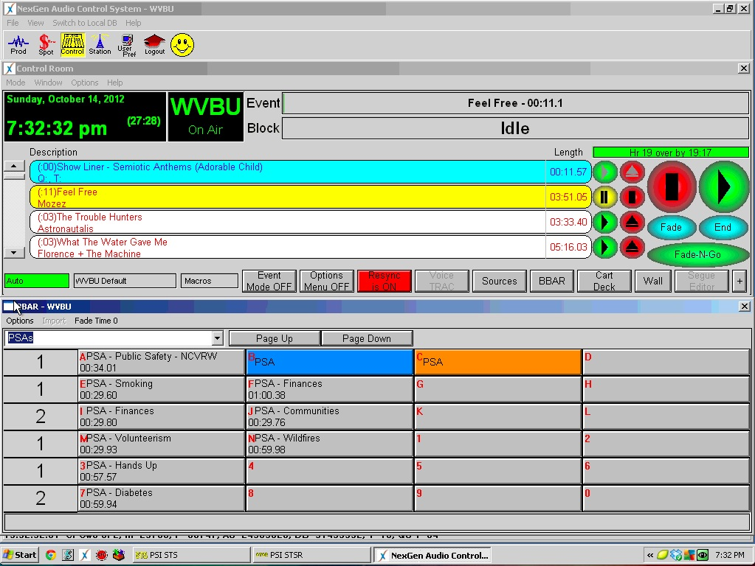

Slide 5
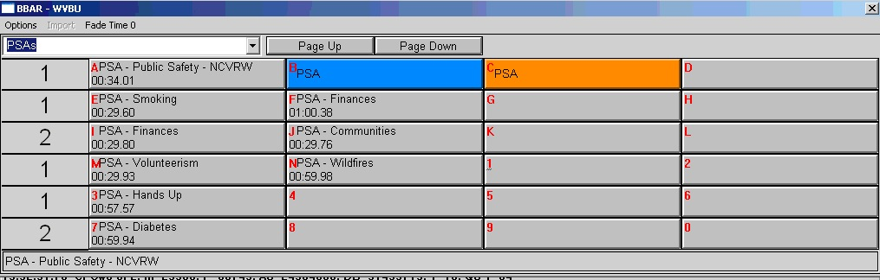

Slide 6
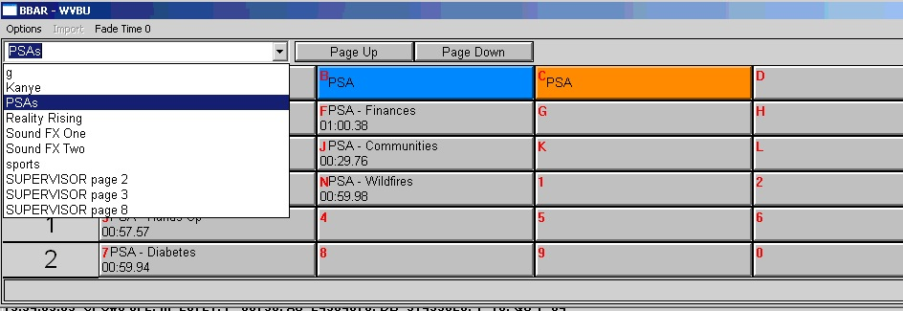

Slide 7
PROMOS

Slide 8
Promos
Within the next two weeks
Done every semester, even if you did last semester
With your show partner
We‘ll send an email out with a schedule
THIS IS IMPORTANT

Slide 9
Peer Critics!
Find your partner
Again, done by show
DUE: Next Staff Meeting

Slide 10
THE END

